Slide 1


Retail Data Analysis
Insights and Recommendations

Slide 2
Agenda
Understanding Business Problem
Data Overview
Exploratory Data Analysis
Analysis
Recommendations

Slide 3



AnalytixLab
Providing the Data-Driven Business Decisions to its Clients.
Reatil Data Analysis
As a Data Analyst, I am going to give you the insights and recommendations for expansion of business and increasing the profitability of business.
Executive Summary
BACK TO AGENDA PAGE

Slide 4

Where We Are Now
In the upcoming slides, we are going to look at the issues with the data and the recommendations for enhancing the customer experience, increasing the sales and identify the growth opportunities.

Slide 5
Enhance customer acquisition
Improve sales​​​
Increase Revenue​​​
AnalytixLab
Business Problem Understanding
Enhance Customer Retention
AIM: Provide data-driven insights about business and understand customer behaviors, product behavior, store behavior, channel behavior, etc...
RETAIL ANALYSIS
Data Cleaning
Exploratory Data Analysis
Product and Product Category Analysis
Data Analysis
Sales Patterns and Trends
Customer Analysis
Descriptive Analytics
BACK TO AGENDA PAGE

Slide 6



Industry Analysis
Data Overview
Duplicate Records
Missing Data
Data consists of 6 tables​
Customer-99K ​
Orders-1.1265 lakh
Orders payment-​1.038 lakh
Order review rating​-100000​
Store info-535​
Product info-32951
Data consists of 6 tables​
Customer-No duplicate
Orders-98666 distinct order_id
Orders payment-99440
Order review rating​-98886
Store info-5354
Product info-32951
There is 1 order_id for which payment type and payment value is missing
BACK TO AGENDA PAGE

Slide 7
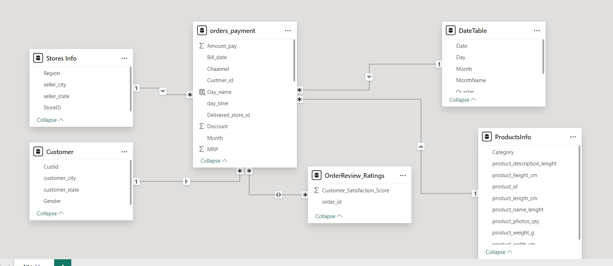
Here is the Entity Relationship Diagram of the available entities(Tables)
The order table here is a Fact table and others are dimension tables and all these tables are arranged in Star Schema

Slide 8
E.D.A on CUSTOMER TABLE | E.D.A on ORDERS TABLE
Number of Customers ---> 99K​ There is no NULL and Duplicate value in this table ​ Distribution of Gender---> 29K(M) and 69K(F)--> FEMALE BUYER MORE​ Number of unique cities and states---20 DISTINCT STATES​ Top cities and states by number of customers--->​Akkarampalle​ and Andhra Pradesh Customer are exceptionally high in Andhra Pradesh. | Column Data Type --> Converted Customer_Id into varchar(50) from int to avoid manipulations​ Formatting The BILL_DATE_TIMESTAMP Column in the correct format as there are irregularities in this column​ There are no Null values in this table.​ There are 9803 duplicate orders ID​ There is no invalid value or inconsistency in the data​ Date Range----> 2020-02-02 TO 2023-09-18​ There are 866 Customers in Customer Table that is not in the orders table 33K distinct product ID There are 3 channels used.​ There are 37 stored_id There is inconsistency in the quantity column as for some product the quantity column values are cumulative .

Slide 9
E.D.A on PRODCUTSINFO | E.D.A on ORDERSREVIEW TABLE
There are 14 categories in PRODCUTSINFO from which one is#N/A. There are 623 product_id for which category is null out of 32951​ There are 1734 order_id where the category is null when we join ORDERS with the PRODCUTSINFO table. To handle the 1734 (1.46% of complete data) I replaced it with an unknown value.​ Top Category – is TOY & GIFTS and the Bottom is PET_SHOP according to the number of products​ One null value length, width height, and description is missing from the baby category. | Consists of order_id and customer_statisfaction_score. There is no Null Values. There are 1 lakh records in this table. There are 98886 Distinct order_id.

Slide 10
E.D.A on ORDERSPAYMENT | E.D.A on STORE INFO
Consists of ORDER_ID , PAYMENT_VALUE , PAYMENT_TYPE.​ There is no missing value There are 4 Mode of Payments Relationship Validation:​ There is 1 order in the Orders table without a corresponding payment record in the OrderPayments table.​ There are 775 payment records in the OrderPayments table without corresponding orders in the Orders table. There are 615 duplicate records in the OrderPayments table, which have been removed. | There are a total 535 reocrds in store table and total 534 distinct store ids. There is one duplicate value in store id i.e ST410​ 534 Distinct seller city means in each city there is only one seller 19 Distinct seller states 4 Regions in store info table There is no Null value in this table

Slide 11
Extra Customer IDs: 830 extra CUSTOMER_ID values in OrderPayment.
Distinct Order IDs: 774 distinct ORDER_ID values in OrderPayment.
Null Payment Info: Three ORDER_ID entries with missing payment values and types.
Quantity Inconsistency: Investigate inconsistencies in the QUANTITY table.
Payment Value Difference: Huge difference between PAYMENT_VALUE and TOTAL_AMOUNT.
There is a difference of 2 million in the amount present in the order_payment and the order table
There is an error while entering the store ID because, for the same product_id and order_id two different stores is present.

Slide 12





Company Name
Customers 99,441
4,119 customer cities with 20 states.
Key Performance Indicators
Profit Margin - 13.81%
Total Discount Rs 5.5 lakh
Total num of orders - 98,666
BACK TO AGENDA PAGE

Slide 13
Company Name
Total no of products – 31,885
Overall Discount percentage - 3.3%
Key Performance Indicators
Average spend per customer - Rs 160.7
Average Order Frequency - 1.14
Total Payment -RS 16.01 milliion
BACK TO AGENDA PAGE

Slide 14
Customer Analysis
REVENUE_SEGMENT​ | CUSTOMERS​
Low Revenue​ | 97K​
Medium Revenue​ | 1868​
High Revenue​ | 52​
Over high Revenue​ | 15​
PREFERRED_PAYMENT_METHOD​ | NUMBER_OF_ORDERS​
credit_card​ | 87K​
UPI/Cash​ | 23K​
voucher​ | 6332​
debit_card​ | 1699​
Customer Preferences:​
Preferred Channels: Instore
Payment Methods: Credit Card​
Preferred Store: ST103​
Preferred Categorie: Toys & Gifts​
Customers who purchased in all the channels - 1
PURCHASING_BEHAVIOR​ | CUSTOMER
Single Category Purchaser​ | 96K​
Multiple Categories Purchaser​ | 2097​
CUSTOMER_TYPE​ | NUMBER_OF_CUSTOMERS​ | AVG_NUMBER_OF_ORDERS​ | AVG_TOTAL_SPENT​
Non-Discount Seeker​ | 56K​ | 1.138806​ | 173.78129042​
Discount Seeker​ | 42K​ | 1.282948​ | 217.17739100​

Slide 15
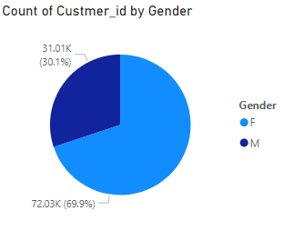
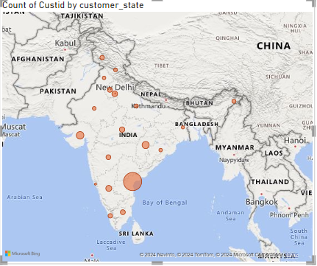
Customer Analysis
Here the Pie chart shows the Gender distribution of customers which clearly tells us that the female customers are significantly larger than the male.
The map shows the distribution of Customers in the States with Andhra Pradesh has max number of Customers

Slide 16
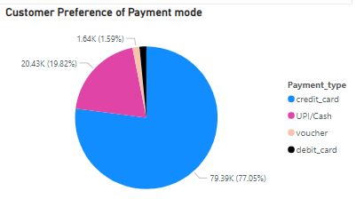
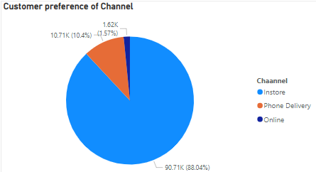
Customer Analysis
Here the first Pie chart shows that the Customers are using Credit cards for most of their payments.
The second Pie chart shows that Customers are using mostly Instore for buying things.

Slide 17
Customer Analysis
Findings from Customer Analysis are that :
There might be a lack of trust while ordering the products online and through phone call delivery or there might be a complex mechanism while ordering through these channels.
Instore: 86,803 orders, making it the most dominant channel by a large margin.​
Repeat customer % is much less than one-time buyer (99.3)%
Toys & Gifts, Home_Appliances, and Baby are dominating categories in all three channels.
Andhra Pradesh, Gujarat, and Chattisgarh are dominating states in all three channels.
We have 42,043 discount seekers and 61,496 non-discount seekers.
According to the RFM analysis of the customers “Gold” customers are more
CUSTOMER_SEGMENT CUSTOMERS
Platinum 42
Gold 36805
Silver 37504
Standard 24221

Slide 18
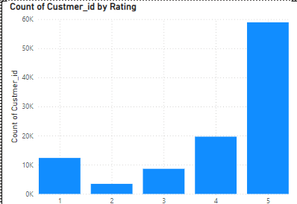
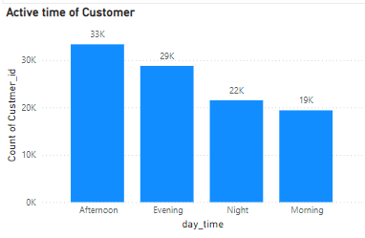
Customer Rating and the time at which Customers are most active.
We can increase the staff during the peak buying hours.
We should focus on customer satisfaction and apply the same strategy to detail with low customer satisfaction

Slide 19
Location Analysis
LOCATION​ | AVERAGE_RATING​
West Bengal​ | 4.179063​
Chhattisgarh​ | 4.167728​
Haryana​ | 4.136267​
Andhra Pradesh​ | 4.100538​
Madhya Pradesh​ | 4.071036​
LOCATION​ | AVERAGE_RATING​
Goa​ | 4.800000​
Punjab​ | 4.219585​
Rajasthan​ | 4.197516​
Haryana​ | 4.180728​
Tamil Nadu​ | 4.179402​
There are 37 DELIVERED_STORE_ID in ORDER_INFO table
Average Rating by location present in-store table​ shows that West Bengal is the leading state.
Row Labels​ | Count of StoreID​
South​ | 225​
North​ | 188​
West​ | 101​
East​ | 21​
Row Labels​ | Count of StoreID​
Andhra Pradesh​ | 126​
Gujarat​ | 75​
Chhattisgarh​ | 50​
Karnataka​ | 48​

Slide 20
Category Analysis
Toys & Gifts​ | Toys & Gifts​ | 2.63M​ | 16.66​
Home_Appliances​ | Home_Appliances​ | 1.79M ​ | 11.36​
Baby​ | Baby​ | 1.71M ​ | 10.84​
Food & Beverages​ | Food & Beverages​ | CATEGORY​ | AVG_CUST_SATISFAC​
Luggage_Accessories​ | Luggage_Accessories​ | Auto​ | 4.086171​
CATEGORY​ | AVG_CUST_SATISFAC​
Auto​ | 4.086171​
Baby​ | 3.977176​
Computers & Accessories​ | 4.023994​
Construction_Tools​ | 4.141675​
Electronics​ | 4.070230​
Toys and gift is the dominating category in term of sales and percentage of sales
The customer rating is high for Auto and Baby category

Slide 21
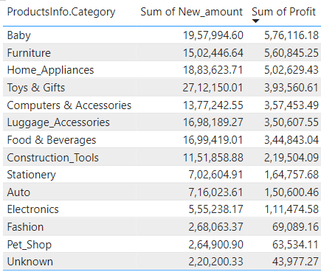
Category Analysis
CATEGORY | TOTAL_SALES | PERCENTAGE_OF_SALES
Toys & Gifts | 2916044.31 | 14.36
Home_Appliances | 2432265.73 | 11.98
Baby | 2255149.17 | 11.11
Furniture | 2250793.44 | 11.09
Food & Beverages | 2086059.05 | 10.27
Category which frequently bought was toys and gifts but company gets more profit in electronics category as the price is more for this category
Total Sales & Percentage of Sales by Category (Pareto Analysis) of category

Slide 22
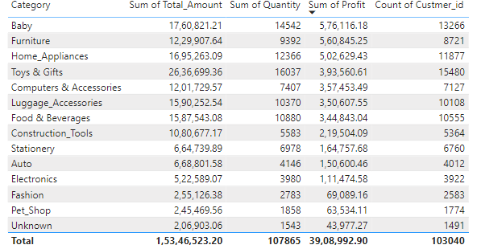
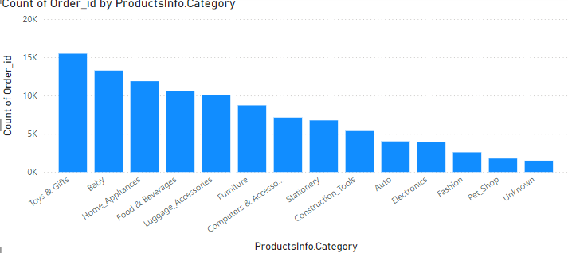
Category Analysis
Top Categories: The bar chart indicates that "Toys and Gifts" are the categories with the highest number of orders, making them the most popular product categories.
Unknown Category: Some products are categorized as "Unknown," and these contribute the least to the total number of orders. This might indicate a need for better product categorization or data management.
Category Summary Table: The summary table provides a comprehensive overview of each category, detailing profit, number of orders, and revenue. This table is essential for understanding the overall performance and contribution of each category to the business.

Slide 23
Category Analysis
CATEGORY1 | CATEGORY2 | TOGETHERCOUNT
Baby | Furniture | 165
Furniture | Home_Appliances | 130
Baby | Home_Appliances | 121
Baby | Construction_Tools | 42
Baby | Toys & Gifts | 33
High Demand for Baby and Furniture Together: 165 purchases indicate frequent pairing, likely for nursery setup.
Significant Overlap Between Furniture and Home Appliances: 130 instances suggest these are commonly bought together, perhaps during home renovations or furnishing.
Considerable Intersection of Baby and Home Appliances: 121 purchases show parents often buy home appliances beneficial for babies (e.g., sterilizers, baby monitors).
Moderate Overlap of Baby and Construction Tools: 42 instances hint at DIY projects for baby-proofing or home improvements.
Lower Frequency of Baby and Toys & Gifts Together: 33 purchases suggest these categories are less frequently bought together, possibly due to separate buying occasions.

Slide 24
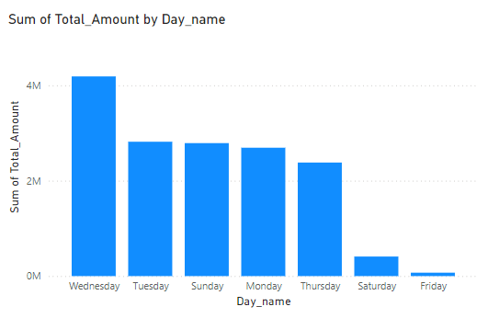
Time Analysis
Revenue tends to peak on Wednesdays, indicating that mid-week days are more lucrative compared to other days.
Customers are most active in the afternoon, with activity dropping off in the morning. This suggests that marketing and sales strategies might be more effective if timed to coincide with peak afternoon activity.

Slide 25
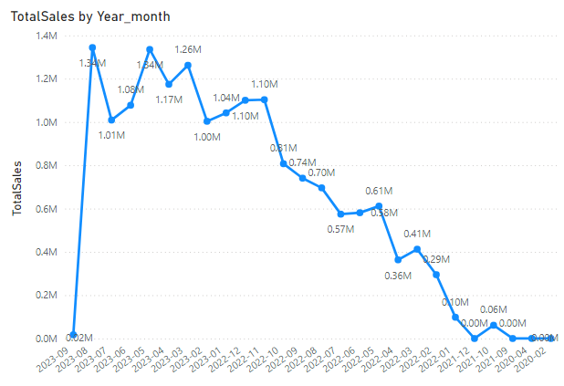
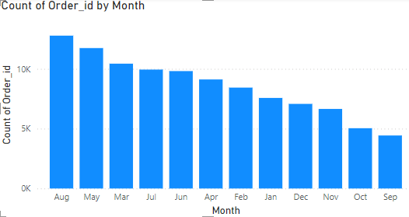
Time Analysis
August 2023 had the highest sales(12%), indicating a peak in business activity during this period.
Revenue Trend: Since December 2021, there has been a notable increase in revenue. However, this growth has been inconsistent, marked by fluctuations rather than a steady upward trend.
The bar chart highlights that August is the month with the maximum number of orders placed by customers, suggesting seasonal or promotional factors driving higher sales during this month.

Slide 26
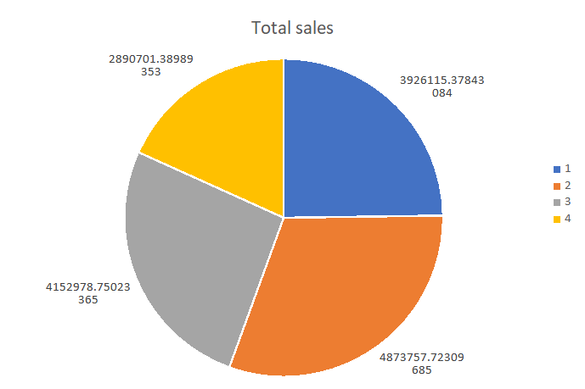
Time Analysis
Seasonal Promotions: Plan and execute targeted marketing campaigns and promotions leading up to and during the second quarter to maximize sales.
Inventory Planning: Ensure that inventory levels are sufficient to meet the increased demand during this period.
Resource Allocation: Allocate more resources (staff, budget, marketing efforts) during Q2 to capitalize on the higher sales activity.

Slide 27
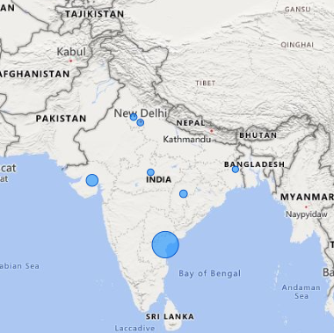
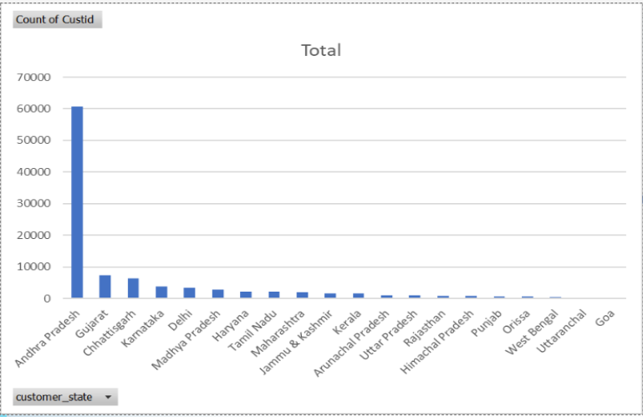
Store Analysis
August 2023 had the highest sales, indicating a peak in business activity during this period.
Revenue Trend: Since December 2021, there has been a notable increase in revenue. However, this growth has been inconsistent, marked by fluctuations rather than a steady upward trend.
The bar chart highlights that August is the month with the maximum number of orders placed by customers, suggesting seasonal or promotional factors driving higher sales during this month.

Slide 28

Company Name
BACK TO AGENDA PAGE
Inconsistency in Data Entry process | Used Data Cleaning steps like changing the data type, renaming the column, updating the column with correct values, removing unnecessary data.
 | Discuss your proposed solution.
Write the problem here and elaborate on it. | Discuss your proposed solution.
Problems and Proposed Solutions

Slide 29
Company Name
BACK TO AGENDA PAGE
Findings and Proposed Solutions
More than 50% of customers are from Andhra Pradesh​
Instore and credit cards are the most preferred methods for buying by customers.​
There are 866 customers in the customer table but not in the orders table. ​
There are 57 product IDs whose count is more than 100 in the orders table.​
The stores are more in the south area and least in east area.​
There are 774 more orders id in order payment which are not in the orders table.
There is lot of inconsistency while entering data that is need to be considered.​

Slide 30
Company Name
BACK TO AGENDA PAGE
Findings and Proposed Solutions
Data Quality Improvements:​
Address inconsistencies between Orders and OrderPayments tables.​
Clean and complete missing product category information.​
Marketing Strategies:​
Focus on high-performing categories (Toys & Gifts, Baby, Home Appliances) for promotions.​
Leverage customer segmentation to tailor marketing campaigns to discount seekers and high spenders.​
Regional Strategies:​
Expand store presence in underrepresented regions.​
Enhance customer engagement in high-satisfaction areas (Goa, Punjab).​
Customer Retention:​
Implement loyalty programs targeting frequent in-store shoppers and credit card users.​
Analyze and improve customer satisfaction to enhance retention rates.​
Operational Efficiency:​
Streamline data entry processes to reduce inconsistencies.​
Implement regular data audits to maintain integrity and accuracy.​

Slide 31
Company Name
BACK TO AGENDA PAGE
Findings and Proposed Solutions
Monthly Trends:​
Top Performing Months: Allocate more inventory and staff during months with historically high sales to meet demand efficiently.​
Underperforming Months: Introduce special discounts, limited-time offers, or loyalty rewards to stimulate sales.​
Weekly Patterns:​
Weekday vs. Weekend: Adjust store hours and staffing based on peak shopping days (e.g., weekends showing higher footfall and sales).​
Daily Trends: Analyze hourly sales data to optimize store operations, ensuring peak hours are well-staffed and stocked.​
Seasonal Promotions:​
Toys & Gifts: Create targeted campaigns around holidays and children's birthdays, as this category has the highest sales (16.66%).​
Home Appliances: Offer discounts during home improvement seasons and festive periods.​

Slide 32
Company Name
BACK TO AGENDA PAGE
Findings and Proposed Solutions
Event-Based Marketing:​
Luggage Accessories: Highlight during travel seasons to increase the 10.40% share.​
Auto: Promote auto accessories during long weekends and holiday seasons to leverage the 4.33% sales.​
New Product Launches:​
Fashion and Pet Shop: Launch new products during relevant trade shows fashion weeks, and festive sessions despite their lower sales contributions (1.53% and 1.60%).​
Customer Retention:
Customers with the lowest recency scores (e.g., 2306054019 with a score of 1) might require re-engagement strategies.​
Customers with high recency scores are those who have made recent purchases and should be targeted for immediate follow-up campaigns.
Summary of RFM score​
Customer Distribution: Majority are Gold and Silver, showing a strong regular customer base with growth potential.​
Opportunity: Convert Silver to Gold/Platinum with targeted strategies.​
Focus: Retain high-value customers (Platinum and Gold) while reactivating Standard ones.​

Slide 33
Company Name
BACK TO AGENDA PAGE
Findings and Proposed Solutions
Toys & Gifts consistently show high sales figures, especially in recent months (e.g., 2023-05, 2023-06, 2023-08). This category could be a significant revenue driver.​
Certain categories like Fashion, Electronics, and Home Appliances show periodic spikes in sales, possibly indicating seasonal demand or promotional periods.​
Pet Shop, Luggage Accessories, Food & Beverages, Construction Tools, Toys & Gifts, Fashion, and Home Appliances are among the categories with the highest average ratings.​
Unknown, Furniture, Baby, Computers & Accessories, Electronics, Stationery, Auto, and Home Appliances (again) are rated lower on average.​
Baby & Furniture (165), Furniture & Home Appliances (130), and Baby & Home Appliances (121) are the top three most frequent associations.​
Optimize inventory management and supply chain logistics for frequently associated categories to ensure availability and efficient delivery of complementary products.​
Bundling products or offering discounts on complementary items could increase average order value and customer satisfaction.​
Instore: 86,803 orders, making it the most dominant channel by a large margin.​
Phone Delivery: 10,287 orders ,This suggests that while phone delivery is a viable channel, it is not as popular as physical store visits​

Slide 34
Company Name
BACK TO AGENDA PAGE
Findings and Proposed Solutions
Enhancing Online Presence
Simplify the process for placing orders over the phone by ensuring that call center representatives are well-trained and that the ordering process is efficient.​​
Offer promotions that encourage the use of multiple channels. For example, provide discounts for customers who place their next order online after an in-store purchase or offer a phone order discount for repeat customers.​
Investment in Resources (store):
Allocate more resources, such as staff and inventory, to top-performing stores like ST103 and ST143 to maintain and potentially increase their performance.​
Performance Improvement Plans(for store): Develop specific action plans for low-performing stores like ST354 and ST463. This might include staff training, local marketing initiatives, or revising the product mix.
Upgrade Store Infrastructure: Ensure that all stores, especially the low performers, are equipped with the latest technology and infrastructure to provide a seamless shopping experience.​​

Slide 35
Company Name
BACK TO AGENDA PAGE
Findings and Proposed Solutions
Customer Engagement and Feedback:​
Enhance Customer Experience:​
Collect Feedback: Regularly collect customer feedback through surveys, reviews, and direct interactions. Use this data to make informed decisions and improve service quality.​
Customer Service Training: Provide regular training for staff to improve customer service skills and ensure a consistent, high-quality experience across all channels.​
Cross-Promote Related Products: Use data from product pairings to create targeted marketing campaigns. For example, advertise Home Appliances alongside Furniture in-store and online.​

Slide 36

AnalytixLab
BACK TO AGENDA PAGE
Get In Touch
Email and Contact
ritiksharma21july@gmail.com
7983056479

